Slide 1

143913643
IQA audit of RTP
Equipment used for measurement and weight was not recorded
4 of 7 projects had this concern (excellent addition to the CAR)*

Slide 2
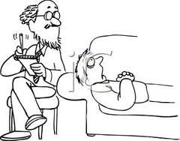
Analysis/Root Cause
Stakeholders for these projects were identified*
5 Why’s used to determine Root Cause
Human Error listed – as well as confusion of responsibility*
Based on analysis appears to be confusion of responsibility and suggest to remove human error from analysis and root cause

Slide 3

Scope
Indicates contained to RTP lighting lab
How was that determined?
Were other projects outside of lighting checked to see if the same issue occurred?
Although in the attachments where the CAR was discussed it discussed this test method is unique to lighting, are there other test methods where the tech relies on the construction review in the test method or results?
Upon discussion with CAR author/champion – indicated that this situation was unique to lighting – suggestion to add this information into the CAR evidence or comments

Slide 4
Milestones
Containment – fixed the projects
There is no Corrective Action milestone
Corrective action is discussed in Short Term – suggestion to indicate that as Corrective Action step or step not needed
Effectiveness – Verified 10 new projects to see if equipment was properly recorded
Suggestion - since this appears to be a confusion of who should have recorded the equipment, CAS or LAB – was there a clarification made to staff? Was there training on this clarification? Or just the reminder?

Slide 5

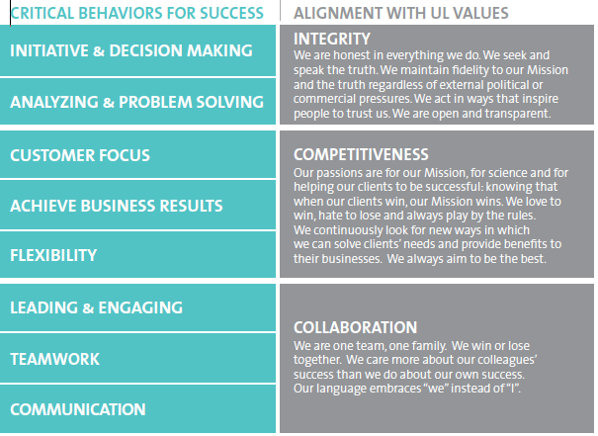
confusion of responsibility
4 of 7 projects had this concern
Stakeholders for these projects were identified

Slide 6
Study for CAR# 143913643

Slide 7
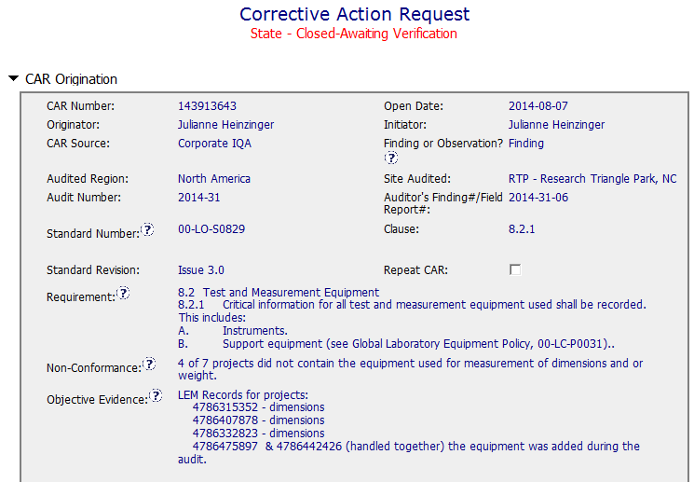

CAR 143913643 - Finding
Clear description of requirement, non-conformance and objective evidence
Collaboration (L) : Communication between CAR Champion and CAR owner to confirm the objective evidence is attached as needed.

Slide 8
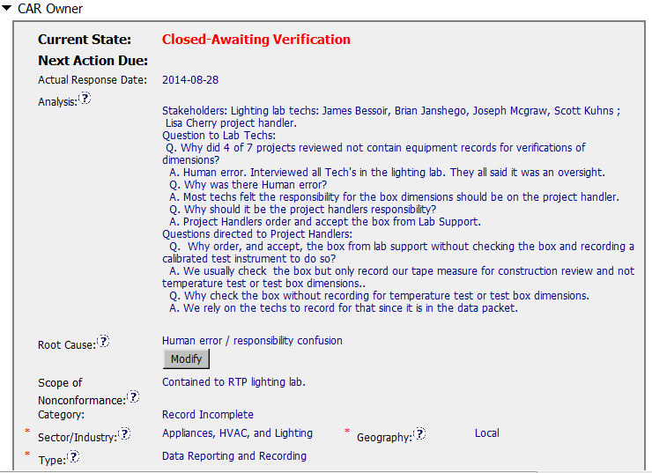
CAR 143913643 - Finding
Clearly identified stakeholders
Use 5 “Whys” to do the analysis
Correct input all those fields
Root cause should be one – “Responsibility confusion”. If root cause is human error, we should drill down to find the real root cause.
[Competitiveness] (C) – Analysis shows clear path to root cause and scope and stakeholders identified.
[Competitiveness( (C) - Root cause statement is half appropriate – need improvement.
[Integrity] (T) – Most appropriate ‘category’, ‘type’, ‘geography’ are selected.

Slide 9
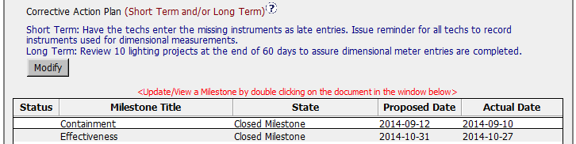
CAR 143913643 - Finding
According to 00-QA-S0006 Clause 7.4.3, finding CARs require at least two milestones that include containment and verification. In the Corrective Action plan, Short Term action should be named as Containment. Long Term action should be named as Verification action.
[Competitiveness] (C) – Corrective actions fix the objective evidence and other problems found; address entire root cause and scope.
[Competitiveness] (C) – Milestones address containment and owner’s verification; completed per milestone expectations.
[Competitiveness] (C) – Verification per requirements.

Slide 10
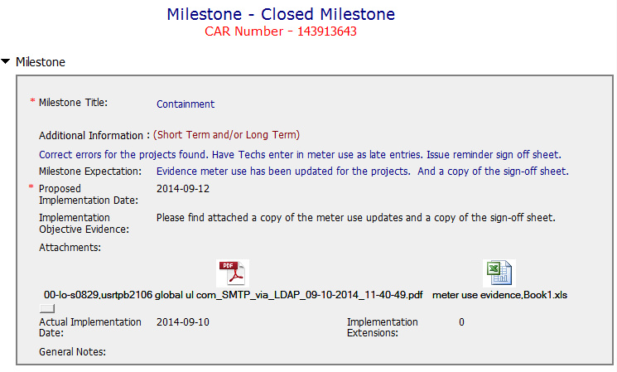
CAR 143913643 – Milestone 1
Containment action has been done with clear implementation objective evidences.
[Competitiveness] (C) – Milestone addressed containment and completed per milestone expectation.

Slide 11
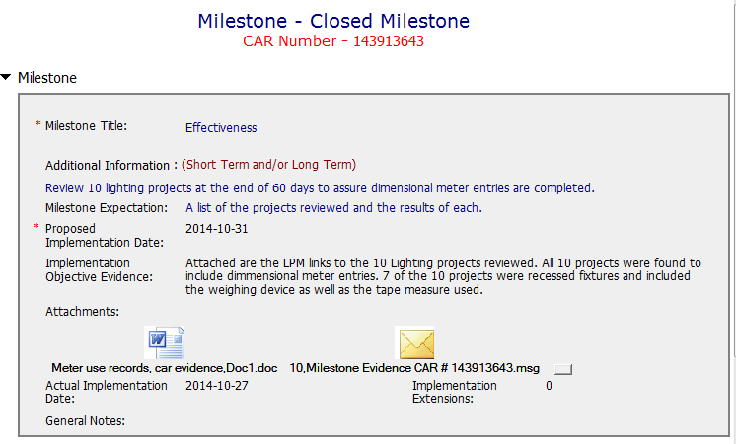
CAR 143913643 – Milestone 2
Verification action has been done with clear implementation objective evidences.
[Competitiveness] (C) – Milestone addressed Verification and completed per milestone expectation.

Slide 12
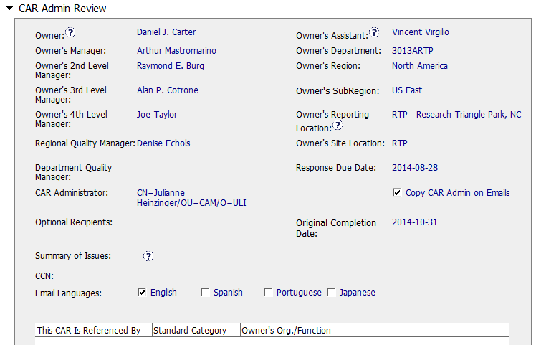
CAR 143913643 – CAR Admin Review
Correct input of Owner’s reporting manager.

Slide 13
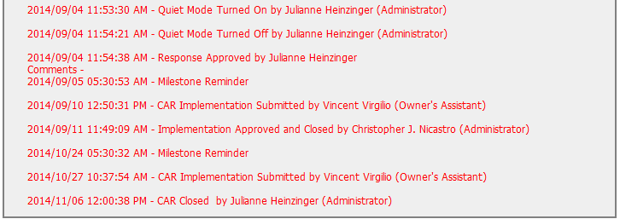
CAR 143913643 – History Study
If there were two CAR Administrators to handle this CAR, suggest to put two names on CAR Administrator field or make notes on the addition of CAR Administrator.
[Collaboration] (L) – Other CAR Champion to support this CAR, but no mention on why? – Need improvement
[Integrity] (T) - Acts on CARs within required timeframe – Excellent
[Integrity] (T) - No Extensions, No overdue, No escalated, No disputed – Excellent

Slide 14
CAR 143913643 – CBS Check
CBS Requirements | Excellent | Moderate | Need Improve | N/A
(C) Extensions are within requirement (<30 days, 3 or less) |  |  |  | X
(T) Most appropriate ‘category’, ‘type’, ‘geography’ are selected | X
(P) Facilitates the handling of disputed CARs |  |  |  | X
(T) Acts on CARs within required timeframe | X
(C) Analysis shows clear path to root cause and scope; stakeholders identified | X
(C) Root cause statement is succinct, reasonable, complete (Shows ‘N/A’ for observations) |  |  | X
(C) Corrective actions fix the objective evidence and other problems found; address entire root cause and scope. For observations, they do not go beyond fixing the objective evidence | X
(C) Milestones address containment & owner’s verification; completed per milestone expectations | X
(P) Verification per requirements | X
(L) Referenced communications are attached as needed | X
(C L) Evidence of communication for overdue/escalated CARs and other pertinent concerns |  |  |  | X
(P) Trains other CAR Champions |  |  |  | X

